Slide 1


LOVELY PROFESSIONAL UNIVERSITY
Ai IN EDUCATION
TITLE OF PROJECT – AI IN EDUCATION
UNDER GUIDANCE OF MRS Ankita Wadhawan

Slide 2
INTRODUCTION
Artificial Intelligence (AI) has enormous potential to transform the field of education. AI can be used to enhance the learning process, personalize education, and improve outcomes for students. Here are some key ways that AI is being used in education:
Personalized learning: AI can help personalize the learning experience for students by adapting to their individual learning styles and abilities. This can help students learn more efficiently and effectively, and can also help teachers provide targeted support where it's needed most.
Intelligent tutoring systems: AI can be used to create intelligent tutoring systems that provide personalized feedback and support to students as they learn. These systems can adapt to each student's individual needs, providing targeted support and guidance in real-time.

Slide 3
Automated grading: AI can be used to automate the grading process, saving teachers time and improving the accuracy and consistency of grading. This can help teachers provide more detailed feedback to students and identify areas where students need additional support.
Predictive analytics: AI can be used to analyze student data and make predictions about student performance and behavior. This can help teachers identify students who may be at risk of falling behind or dropping out, and provide targeted support to help them succeed.
Virtual assistants: AI-powered virtual assistants can be used to provide students with 24/7 support and guidance. These assistants can help answer questions, provide feedback, and direct students to additional resources as needed.

Slide 4
Overall, AI has the potential to revolutionize the way we approach education, making it more personalized, efficient, and effective for students of all ages and abilities.

Slide 5
AI ON WEBSITE
AI can be used in a number of ways on an educational website. Here are a few examples:
Personalization: AI can be used to personalize the learning experience for each individual user. By analyzing data about a user's behavior and preferences, AI algorithms can make recommendations for courses, lessons, or resources that are tailored to their needs.
Chatbots: AI-powered chatbots can be used to provide instant support to students and answer their questions about coursework, deadlines, or technical issues. This can help reduce the workload of teachers and support staff, while also providing a more efficient and user-friendly experience for students.

Slide 6
AI ON WEBSITE
Adaptive learning: AI can be used to create adaptive learning experiences that adjust the difficulty level of coursework or quizzes based on a student's performance. This can help ensure that each student is challenged at an appropriate level and has the opportunity to master the material at their own pace.
Data analytics: AI can be used to analyze data about student performance and engagement, allowing teachers and administrators to identify trends and make data-driven decisions about curriculum, teaching methods, and resource allocation.

Slide 7
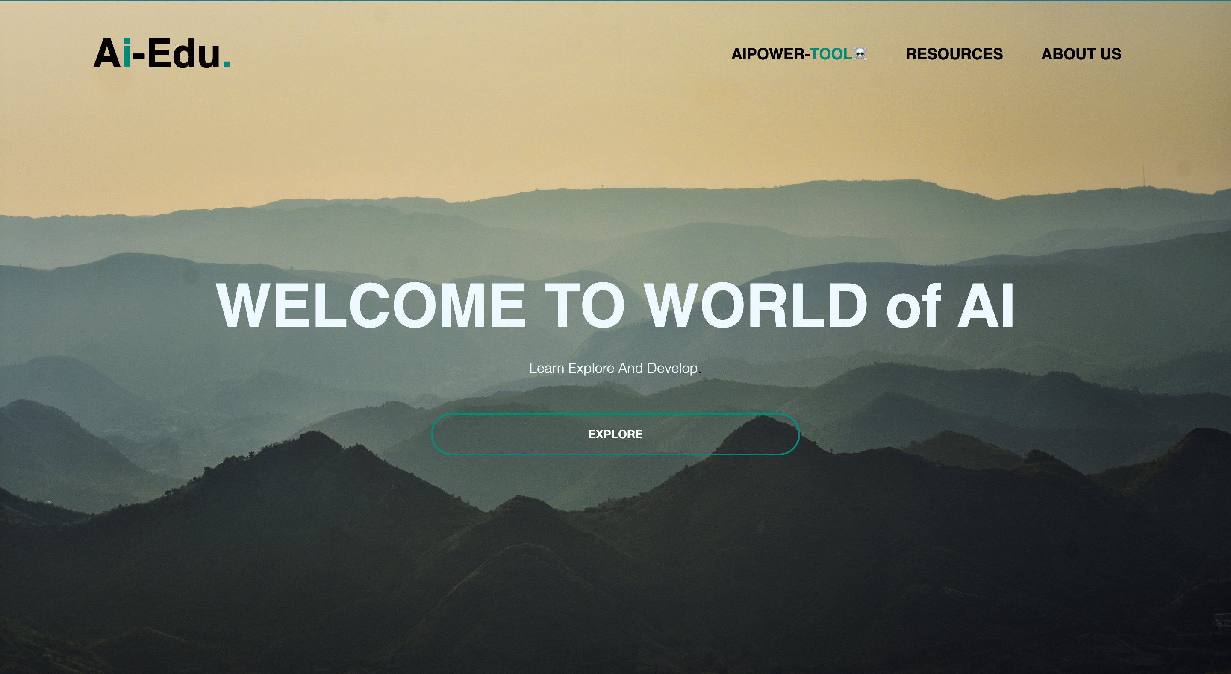
HOME-PAGE[ Ai-Edu.]

Slide 8
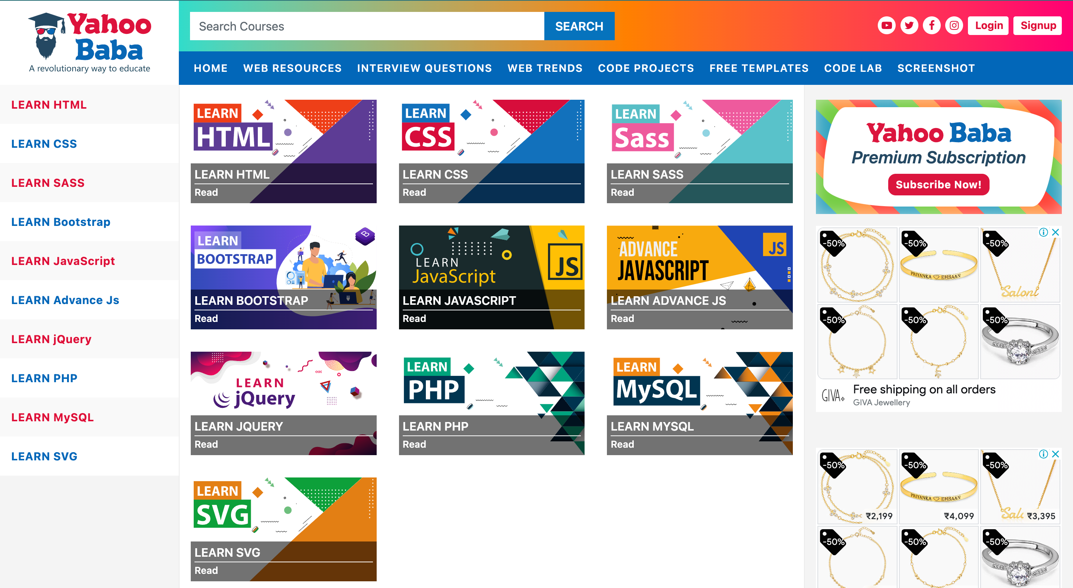
RESOURCES

Slide 9
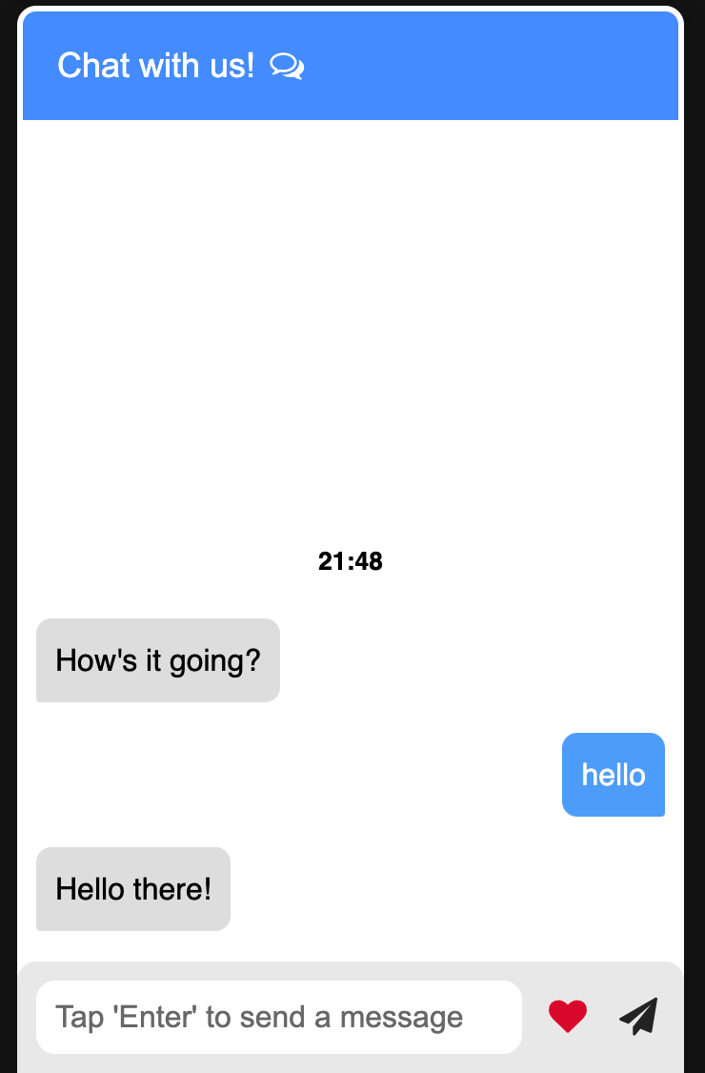

EXPLORE (CHAT-BOT)

Slide 10
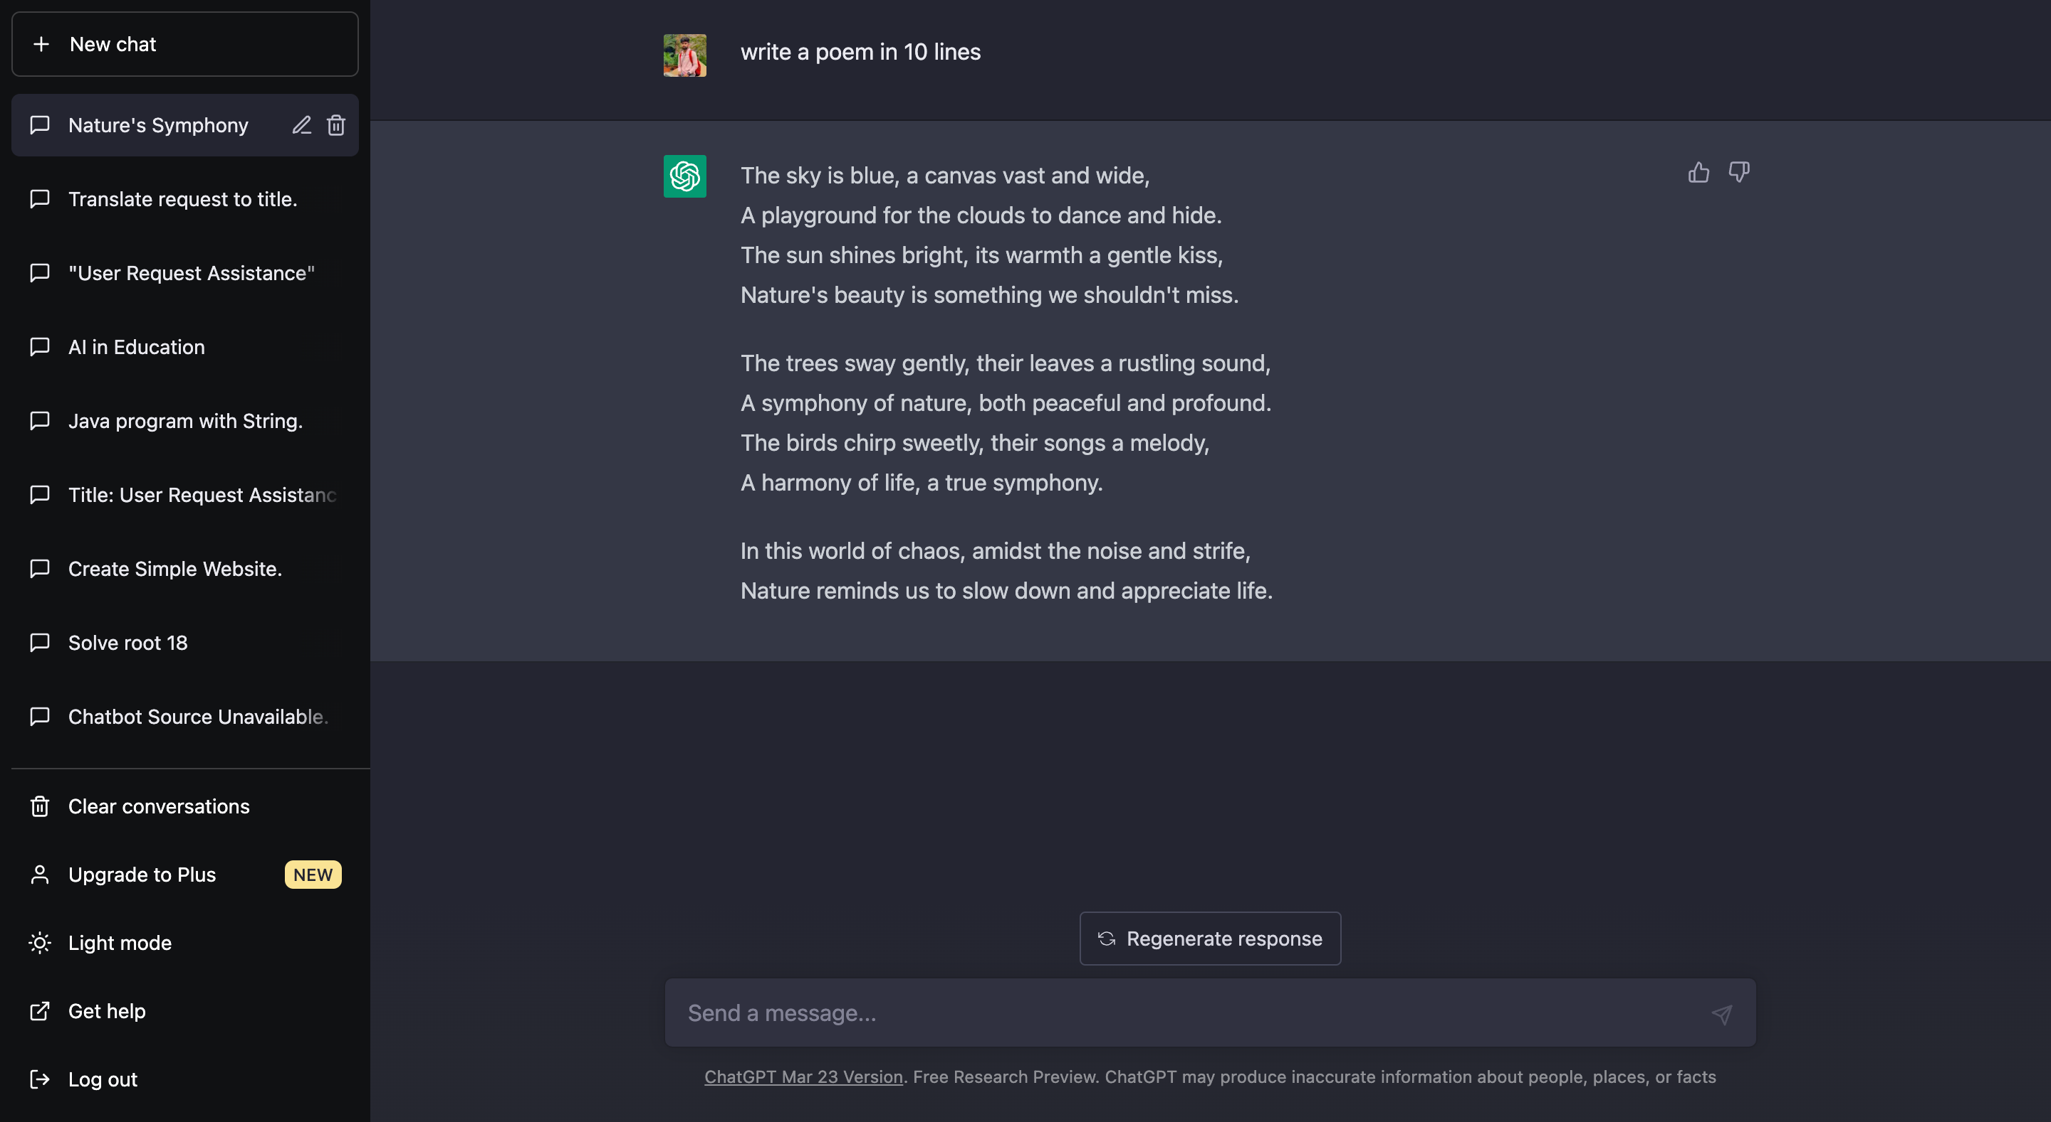
AIPOWER-TOOL ☠️

Slide 11
THANK YOU!

